Slide 1
Inflation

Slide 2
Inflation denotes a rise in the general level of prices. The rate of inflation is the rate of change of the general price and is measured as
inflation rate (year t) =
[(price level of year t – price level of year t-1)/price level of year t-1] X 100.
Conceptually, Price level is the measured as the weighted average of the goods and services in an economy. In practice, we measure the overall price level by constructing price index, which are the averages of consumer (or produce) prices. [Note that price index is based on AVERAGE prices.]
Price Indexes
When newspapers tell us ; inflation is rising’ they are really reporting the movement of a price index. A price index is a measure of the general price level; more specifically, it is a weighted averages of the prices of a number of goods and services.

Slide 3

“A price index is a measure of the average level of prices. Inflation denotes a rise in the general level of prices. The rate of inflation is the rate of change of the general price level and is measured as follows:

Slide 4
The Consumer and Producer Price Indexes
The consumer price index (CPI) measures the cost of buying a fixed basket of goods and services representative of the purchases of urban consumers. The CPI differs in three main ways from the GDP deflator. First, the deflator measures the prices of a much wider group of goods than the CPI does. Second, the CPI measures the cost of a given basket of goods, which is the same from year to year. The basket of goods included in the GDP deflator, however, differs from year to year, depending on what is produced in the economy in each year. When corn crops are large, corn receives a relatively large weight in the computation of the GDP deflator. By contrast, the CPI measures the cost of a fixed basket of goods that does not vary over time. Third, the CPI directly includes prices of imports, whereas the deflator includes only prices of goods produced in the a country (United States, B’desh etc).

Slide 5
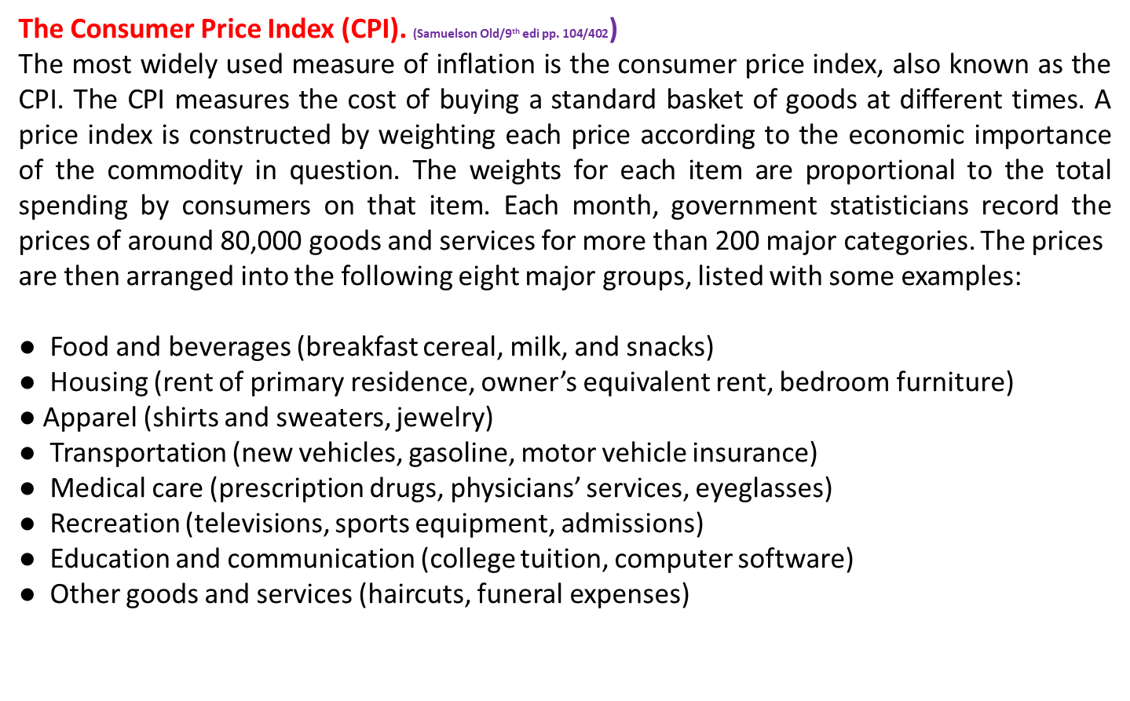

Slide 6
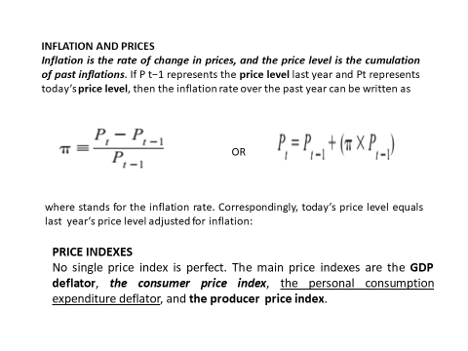

Slide 7
INFLATION AND PRICE INDEXES
Nominal GDP measures the value of output in a given period in the prices of that period, or, as it is sometimes put, in current dollars. Thus, 2010 nominal GDP measures the value of the goods produced in 2010 at the market prices prevailing in 2010, and 1929 nominal GDP measures the value of goods produced in 1929 at the market prices that prevailed in 1929. Nominal GDP changes from year to year for two reasons. First, the physical output of goods changes, and, second, market prices change. Changes in nominal GDP that result from price changes do not tell us anything about the performance of the economy in producing goods and services. That is why we use real rather than nominal GDP as the basic measure for comparing output in different years.

Slide 8
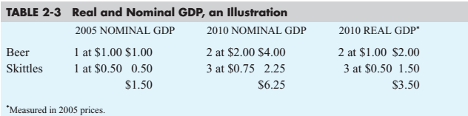
Real GDP measures changes in physical output in the economy between different time periods by valuing all goods produced in the two periods at the same prices, or in constant dollars. Real GDP is now measured in the national income accounts at the prices of 2005. Measuring inflation would be straightforward if prices of all goods grew proportionately. However, when the price of one good grows faster than the price of another, consumers shift purchases away from the now relatively more expensive good toward the less expensive one. The use of chain-weighted indexes helps correct for changes in the market basket.
In Table 2-3 we present a simple example that illustrates the calculation of nominal
and real GDP

Slide 9
The difference between CPI and GDP deflator.
The first difference is that the GDP deflator measures the prices of all goods and services produced, whereas the CPI or RPI measures the prices of only the goods and services bought by consumers. Thus, an increase in the price of goods bought by firms or the government will show up in the GDP deflator but not in the CPI or RPI.
The second difference is that the GDP deflator includes only those goods produced domestically. Imported goods are not part of GDP and do not show up in the GDP deflator. For example, an increase in the price of Toyota made in Japan and sold in the U.K. affects the CPI or RPI, because the Toyota is bought by consumers in the U.K., but it does not affect the GDP deflator.
The third difference concerns how the two measures aggregate the many prices in the economy. The CPI or RPI assigns fixed weights to the prices of different goods, whereas the GDP deflator assigns changing weights. In other words, the CPI or RPI is computed using a fixed basket of goods, whereas the GDP deflator allows the basket of goods to change over time as the composition of GDP changes.

Slide 10
The GDP Deflator
The calculation of real GDP gives us a useful measure of inflation known as the GDP
deflator. The GDP deflator is the ratio of nominal GDP in a given year to real GDP of that year. Since the GDP deflator is based on a calculation involving all the goods produced in the economy, it is a widely based price index that is frequently used to measure inflation.
The deflator measures the change in prices that has occurred between the base year and the current year. Using the fictional example in Table 2-3 , we can get a measure of inflation between 2005 and 2010 by comparing the value of 2010 GDP in 2010 prices and 2005 prices. The ratio of nominal to real GDP in 2010 is 1.79 (6.25/3.50).

Slide 11
Causes of inflation
Demand-pull inflation
Sloman 10th pp.
Demand-pull inflation is caused by continuing rises in aggregate demand. Firms will respond to a rise in demand partly by raising prices and partly by increasing output. Just how much they raise prices depends on how much their costs rise as a result of increasing output. The closer actual output gets to potential output, and the less slack there is in the economy, the more will firms respond to a rise in demand by raising their prices. On the other hand, the greater the spare capacity, the more will firms respond by raising output and the less by raising prices.
Sometimes there may be a single increase in demand (or a ‘demand shock’). This could be due, for example, to an increased level of government expenditure. The effect is to give a single rise in the price level. Although this causes inflation in the short run, once the effect has taken place, inflation will fall back to zero. For inflation to persist, there must be continuing increases in aggregate demand and thus continuing rises in the price level. If inflation is to rise, the rate of increase in aggregate demand must also rise.

Slide 12
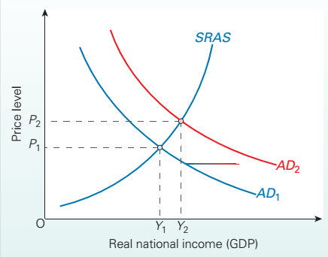

Slide 13
Demand-Pull Inflation
One of the major shocks to inflation is a change in aggregate demand. We know that changes in investment, government spending, or net exports can change aggregate demand and propel output beyond its potential. We also saw how a nation’s central bank can affect economic activity. Whatever the reason, demand-pull inflation occurs when aggregate demand rises more rapidly than the economy’s productive potential, pulling prices up to equilibrate aggregate supply and demand. In effect, demand dollars are competing for the limited supply of commodities and bid up their prices. As unemployment falls and workers become scarce, wages are bid up and the inflationary process accelerates.
A particularly damaging form of demand-pull inflation occurs when governments engage in deficit spending and rely on the monetary printing press to finance their deficits. The large deficits and the rapid money growth increase aggregate demand, which in turn increases the price level. [[Thus, when the German government financed its spending in 1922–1923 by printing billions and billions of paper marks, which came into the marketplace in search
of bread and fuel, it was no wonder that the German price level rose a billionfold. This was demand-pull inflation with a vengeance. This scene was replayed in the early 1990s when the Russian government financed its budget deficit by printing monetary rubles. The result was an inflation rate that averaged 25 percent per month, or 1355 percent per year. (Make sure you understand how 25 percent per month becomes 1355 percent per year.)

Slide 14
Cost-push inflation Sloman 10th
Cost-push inflation is associated with continuing rises in costs which occur independently of aggregate demand. If firms face a rise in costs, they will respond partly by raising prices and passing the costs on to the consumer, and partly by cutting back on production. Just how much firms raise prices and cut back on production depends on the impact of price changes on aggregate demand. The less responsive is aggregate demand to price changes, the less will sales fall as a result of any price rise.
As with demand-pull inflation, we must distinguish between one-off increases in cost (a ‘supply shock’) from continuing increases. If there is a one-off increase in costs, there will be a one-off rise in the price level. For example, if the government raises the excise duty on petrol and diesel, there will be a single rise in fuel prices and hence in firms’ fuel costs. This will cause temporary inflation while the price rise is passed on through the economy. Once this has occurred, prices will stabilise at the new level and the rate of inflation will fall back to zero again. If cost-push inflation is to continue over a number of years, therefore, then costs must continually increase. If cost-push inflation is to rise, the rate of increase in costs must also rise.

Slide 15
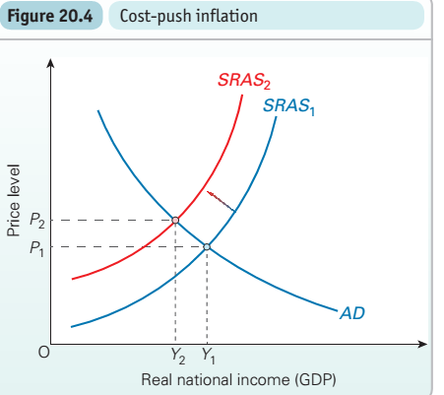

Slide 16
Cost-Push Inflation and “Stagflation” #Samuelson 19th
We see today that inflation sometimes increases because of increases in costs rather than because of increases in demand. This phenomenon is known as cost-push or supply-shock inflation. Often, it leads to an economic slowdown and to a syndrome called “stagflation,” or stagnation with inflation.
Figure 30-6 shows the workings of supply-shock inflation. In 1973, 1978, 1999, and again in the late 2000s, countries were minding their macroeconomic business when severe shortages occurred in oil markets. Oil prices rose sharply, business costs of production increased, and a sharp burst of cost-push inflation followed. These situations can be seen as an upward shift in the AS curve. Equilibrium output falls while prices and inflation rise.

Slide 17
THE COSTS OF INFLATION
If prices go up by 10 per cent, does it really matter? Provided your wages kept up with prices, you would have no cut in your living standards. If people could correctly anticipate the rate of inflation and fully adjust prices and incomes to take account of it,
then the costs of inflation would indeed be relatively small. For us as consumers, they would simply be the relatively minor inconvenience of having to adjust our notions of what a ‘fair’ price is for each item when we go shopping. For firms, they would again be the relatively minor costs of having to change price labels, or prices in catalogues or on menus, or adjust slot machines. These are known as menu costs.
Redistribution. Inflation redistributes income away from those on fixed incomes and those in a weak bargaining position, to those who can use their economic power to gain large pay, rent or profit increases. It redistributes wealth to those with assets (e.g. property) that rise in value particularly rapidly during periods of inflation, and away from those with types of savings that pay rates of interest below the rate of inflation and hence whose value is eroded by inflation. Elderly people who rely on the interest from their savings may be particularly badly hit by rapid inflation.

Slide 18
Uncertainty and lack of investment. Inflation tends to cause uncertainty among the business community, especially when the rate of inflation fluctuates. (Generally, the higher the rate of inflation, the more it fluctuates.) If it is difficult for firms to predict their costs and revenues, they may be discouraged from investing. This will reduce the rate of economic growth. On the other hand, as will be explained below, policies to reduce the rate of inflation may themselves reduce the rate of economic growth, especially in the short run. This may then provide the government with a policy dilemma.
Balance of payments. Inflation is likely to worsen the balance of trade. If a country suffers from relatively high inflation, its exports will become less competitive in world markets. At the same time, imports will become relatively cheaper than home-produced goods. Thus exports will fall and imports will rise. This is known an international substitution effect. As a result, the balance of trade will deteriorate and/or the exchange rate will fall. Both of these effects can cause problems.

Slide 19
Extra employment of Resources. Extra resources are likely to be used to cope with the effects of inflation. Accountants and other financial experts may have to be employed by companies to help them cope with the uncertainties caused by inflation. And to explore the exact causes of inflation and the causal effects.
Policies to tackle inflation
We will be examining a number of different anti-inflationary policies in later chapters. These policies can be directed towards the control of either aggregate demand or aggregate supply, and hence are referred to as demand-side and supply-side policies respectively.
Demand-side policies : Policies designed to affect aggregate demand: Through fiscal policy and monetary policy.
Supply-side policies: Policies designed to affect aggregate supply: policies to affect costs or productivity.

Slide 20
Demand-side policies
There are two types of demand-side policy:
Fiscal policy. Fiscal policy involves altering the level of government expenditure and/or rates of tax. Aggregate demand can be reduced by cutting government expenditure (one of the four elements in aggregate demand) or by raising taxes and hence reducing consumer expenditure. These are both examples of contractionary (or deflationary) fiscal policy.
(Fiscal policy could also be used to boost aggregate demand if there were a problem of demand-deficient unemployment. In this case, the government would raise government expenditure and/or cut taxes. This is called expansionary (or reflationary) fiscal policy.)

Slide 21
Monetary policy. Monetary policy involves altering the supply of money in the economy or manipulating the rate of interest. The central bank can reduce aggregate demand (a contractionary monetary policy) by putting up interest rates and thus making borrowing more expensive, or by acting to reduce the supply of money available through the banking system. If people borrow less, they will spend less.
Supply-side policies
The aim here is to reduce the rate of increase in costs. This will help reduce leftward (upward) shifts in the aggregate supply curve. This can be done either (1) by restraining monopoly influences on prices and incomes (e.g. by policies to restrict the activities of trade unions, or policies to restrict mergers and takeovers), or (2) by designing policies to increase productivity (e.g. giving various tax incentives, encouraging various types of research and development, giving grants to firms to invest in up-to-date equipment or in the training of labour).

